Slide 1

Department of Medicine
Clinical Retreat
January 23, 2016
Shared Team Responsibility
Rajesh Chandra, MD, FHM Jane Dus, DNP, RN
Division Chief Chief Nursing Officer
General Internal Medicine University Hospitals Case Medical Center
Vice Chair for Clinical Affairs & Transformation
Department of Medicine
University Hospitals Case Medical Center
Associate Professor of Medicine
Case Western Reserve University School of Medicine

Slide 2
Shared Team Responsibility
Understand the Transformation in Modern Healthcare
Appreciate the new consumer of healthcare
Learn why “Shared Team Responsibility” is critical in today’s healthcare delivery
Review the concept of a “Shared Mental Model” in patient care
Notes:
Recognize the new consumer of healthcare and the new healthcare environment and because of that the new provider that you must become to meet the challenges of the current healthcare landscape.

Slide 3

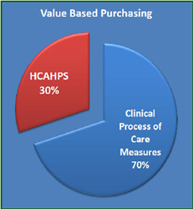



Modern Healthcare Transformation
High Reliability Medicine

Slide 4
Modern Healthcare Transformation
Transformation
  The radical changes any enterprise needs to make to succeed when there is a change in the market environment
Transformative forces
  Unsustainable healthcare costs driving transference of risk
  Digitization
  Disruptive Innovation in Science & Technology
  Democratization of information / Access to information
  Social Networking
Notes:
The fundamental changes a business, industry or profession needs to make to be successful when there is a change in the market environment

Slide 5
Transference of Risk
Business model - Insurance based fee-for-service payment
Primary holders of healthcare insurance risk are the Government and Employers
Rising Health Insurance Costs $$$$
Cost containment strategies by those holding risk
  Reduction of benefits
  Decreased reimbursements,
  Narrowing networks,
  Increased regulation etc.
  Transferring risk to Providers and Consumers
    High deductible health plans (consumers)
    Different payment models – DRGs or bundled payments (providers)
Notes:
Fee for service model in its purest form holds neither the patient nor the provider at risk for cost or quality of care

Slide 6
Transference of Risk
When consumers assume more financial risk they will manage healthcare costs more responsibly
Patients are incented to become better healthcare consumers
Conscious of utilization, cost and value of the services they purchase
With transfer of risk
“Retail healthcare” system

Slide 7
Digitization
Refers to conversion of all information from analog to digital
Has changed people’s perspective of the world around them and created certain expectations and beliefs
    Ease of access to information (e.g. myUHCare)
    Ease of retail transactions
    Expect options and choices based on their preferences
    Expect devices in their world to be communicating with each other
Standardization of Clinical and Administrative Processes
Data Capture and Analysis
Predictive Analytics (“Big data”) – (e.g. Sepsis early warning system, Amazon Marketplace)

Slide 8
  Disruptive Innovation in Science & Technology
Technological innovations
  Smartphones, mobile devices - 97,000 healthcare apps and sensors
  The Internet – immediate access to unlimited information on healthcare
  Texting amongst Physicians to communicate regarding patient care
  Radiology PACS system
  ZocDoc
Biological discoveries
  The human microbiome
  Genetic basis of disease / understanding of cellular mechanics
  Every individual is biologically unique and may benefit from customized treatments – “Pharmacogenomics” and “Precision Medicine”
  Having the capability to provide individualized treatments will be a differentiating feature for health systems

Slide 9
The “New Consumer” of healthcare
An informed consumer who is:
    financially incented
    technologically savvy and empowered
    biologically unique.
Price, value, convenience and satisfaction (care experience)
Prefers healthcare that provides transparency and choice
Notes:
Healthcare is not just a purchased commodity. An individual’s personal beliefs and values will play an important role in the choices they make.

Slide 10
New Competencies as a Provider/Organization
Clear mission, vision and values
Develop and maintain a learning culture and innovation mindset
Understand the business model of one’s organization
Use data as the foundation for transformation
Be sensitive to the needs of our patients and their care experience
Develop efficient models of care and processes
Communicate and Collaborate effectively

Slide 11
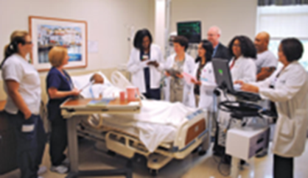
Shared Team Responsibility
The “Team” concept in Medicine is not new
In Hospital Medicine - 85% of daily clinical work is outside the patient’s room
The structure and dynamics of the team has changed
A true “patient-centered” approach which is high quality, safe, cost-effective and sensitive to the “patient care experience” requires:
“Shared Team Responsibility”
Shared Mental Model
Notes:
Innovation is not always about discovering the next “big new thing”. It is often about how existing processes and technology are combined in novel ways to produce value.
“expert-to-expert” learning

Slide 12
Shared Mental Models
Coordinate mechanisms that facilitate good teamwork behaviors
  Leadership, mutual performance, adaptability
An organizing knowledge structure of the relationships between the task the team is engaged in and how the team members will interact

Slide 13
Shared Mental Models
Team members:
  Must have a shared understanding of their tasks and roles to maximize team effectiveness
  Be able to communicate with and understand the perspective of those with whom they are working
  “BE ON THE SAME PAGE”

Slide 14
Shared Mental Models
Teamwork:
  The collaborative processes of teams
  Requirements of interpersonal interaction
  Skill set of the team
Taskwork:
  The functional activities that need to be accomplished
  Goals; sub-tasks
  Performance requirements

Slide 15
Shared Mental Models
Attributes:
  Content
    Specific information/knowledge
  Similarity
    Existing commonalities
  Accuracy
    Differences between an individuals mental model and reality
  Dynamics
    The need to respond and changes in environment

Slide 16
Shared Mental Model: In Action
Early Discharge Initiative
Goal:
  Increase the number of discharges before Noon
Team Work Mental Model:
    Collaborative Process
    Interdisciplinary
    Provide coordinated care
    Early identification of discharge
    Safe transition of care

Slide 17
Shared Mental Model: In Action
Early Discharge Initiative
  Task Work Mental Model:
    Rounding
    Electronic White Board
    Touch base rounds
    Precertification process

Slide 18
Shared Mental Model: In Action
Early Discharge Initiative
  Attributes:
    Content
      Increase Discharges by 12:00 Noon
    Similarities
      Are the team’s mental models consistent with each other?
    Accuracy
      Consistent with the standard?
    Dynamics
      Responding to changes and feedback

Slide 19
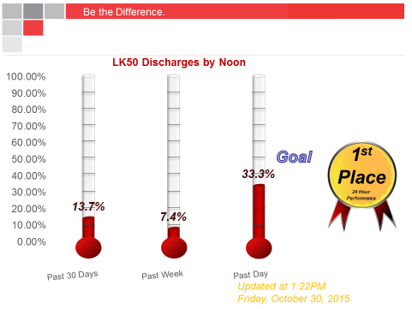
Shared Mental Model: In Action

Slide 20
Shared Mental Model: In Action

Slide 21
Shared Mental Models
Organizational Culture
Embrace the Change
  Teach and be tenacious
  Incorporate concepts as a learning organization

Slide 22
Shared Team Responsibility
A new era of modern healthcare
Providing “patient centered care” – (efficient, convenient, high value and safe)is complex and you can’t do it alone!
Build a team concept and a Shared Mental model of care
Communicate and collaborate
&
“Share team responsibility”

Slide 23
Shared Team Responsibility
Thank you
References:
n=1, Koster, Bisbee and Charan – 2014
Burstscher, M. & Manser, T. (2012). Team mental models and their potential to improve teamwork and safety: A review and implications for future research in healthcare. Safety Science, 50, 1344-1354.
Evans, J. & Baker, G. (2012). Shared mental models of integrated care: aligning multiple stakeholder perspectives. Journal of Health Organization and Management, 26(6), 713-736
McComb, S. & Simpson, V. (2013). The concept of shared mental models in healthcare collaboration. Journal of Advanced Practice Nursing, 70(7), 1479-1488.

